Slide 1
Data Drive Fracture Mechanics: Discovering Elastic Constants and Failure Criteria using PINNs
Thomas Allard
Samantha Walker
April 26, 2022

Slide 2
Outline
The fastest introduction you’ll ever get
Background – Elasticity and Fracture Mechanics
Input Data – Abaqus Simulations
Background – PINNs
Elastic PINN
Fracture PINN
Conclusions
References

Slide 3
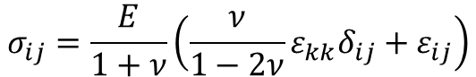
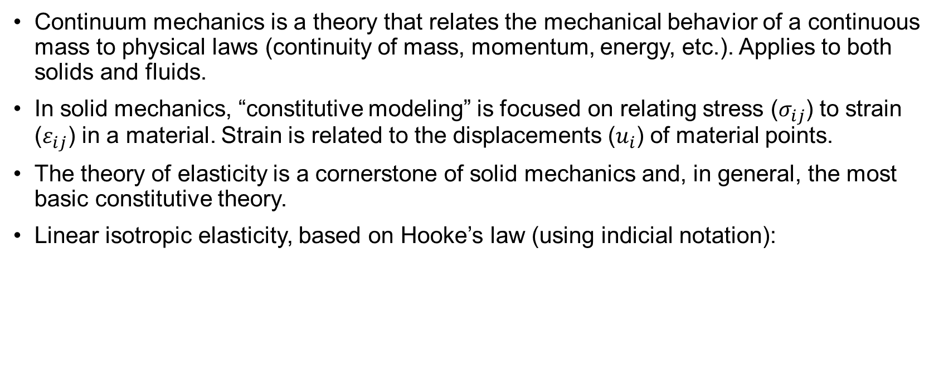
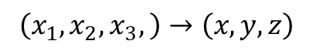
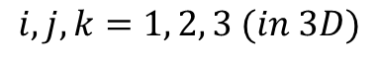

Background – Elasticity
Continuum mechanics is a theory that relates the mechanical behavior of a continuous mass to physical laws (continuity of mass, momentum, energy, etc.). Applies to both solids and fluids.
In solid mechanics, “constitutive modeling” is focused on relating stress ($σ_{ij}$) to strain ($ε_{ij}$) in a material. Strain is related to the displacements ($u_{i}$) of material points.
The theory of elasticity is a cornerstone of solid mechanics and, in general, the most basic constitutive theory.
Linear isotropic elasticity, based on Hooke’s law (using indicial notation):
$$σ_{ij}=\frac{E}{1+ν}\left(\frac{ν}{1−2ν}ε_{kk}δ_{ij}+ε_{ij}\right)$$
$$ε_{ij}=\frac{1}{2}\left(\frac{∂u_{i}}{∂x_{j}}+\frac{∂u_{j}}{∂x_{i}}\right)$$
$$\left(x_{1},x_{2},x_{3},\right)→\left(x,y,z\right)$$
$$i,j,k=1, 2, 3 (in 3D)$$
E = Elastic Modulus
ν = Poisson’s Ratio

Slide 4
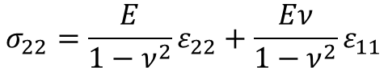

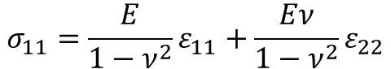
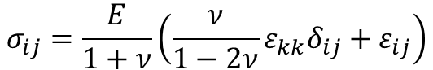
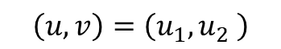

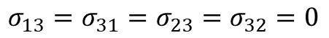
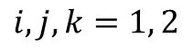
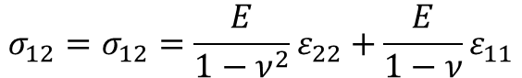
Background – Elasticity (2D)
$$σ_{ij}=\frac{E}{1+ν}\left(\frac{ν}{1−2ν}ε_{kk}δ_{ij}+ε_{ij}\right)$$
$$ε_{ij}=\frac{1}{2}\left(\frac{∂u_{i}}{∂x_{j}}+\frac{∂u_{j}}{∂x_{i}}\right)$$
$$\left(x_{1},x_{2} \right)→\left(x,y\right)$$
$$i,j,k=1, 2$$
$$\left(u,v\right)=\left(u_{1},u_{2} \right)$$
2D Plane Strain:
$$σ_{11}=\frac{E}{1−ν^{2}}ε_{11}+\frac{Eν}{1−ν^{2}}ε_{22}$$
$$σ_{22}=\frac{E}{1−ν^{2}}ε_{22}+\frac{Eν}{1−ν^{2}}ε_{11}$$
$$σ_{12}=σ_{12}=\frac{E}{1−ν^{2}}ε_{22}+\frac{E}{1−ν}ε_{11}$$
$$σ_{13}=σ_{31}=σ_{23}=σ_{32}=0$$
$$σ_{33}=ν\left(σ_{11}+σ_{22}\right)$$

Slide 5
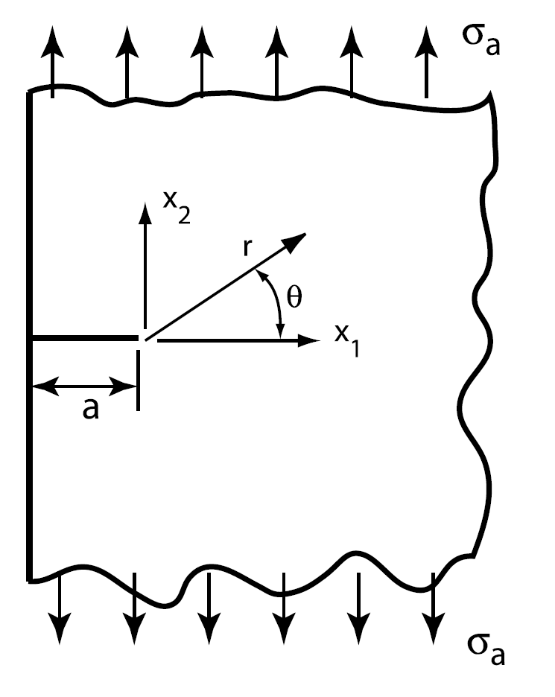
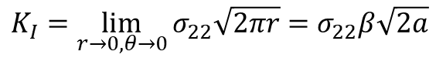
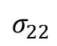
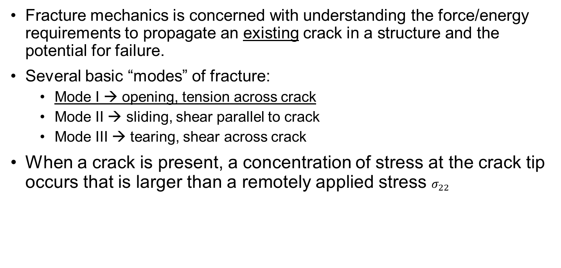
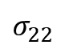
Background – Fracture Mechanics
$$σ_{22}$$
Fracture mechanics is concerned with understanding the force/energy requirements to propagate an existing crack in a structure and the potential for failure.
Several basic “modes” of fracture:
Mode I → opening, tension across crack
Mode II → sliding, shear parallel to crack
Mode III → tearing, shear across crack
When a crack is present, a concentration of stress at the crack tip occurs that is larger than a remotely applied stress $σ_{22}$
Focus of this project!
$$σ_{22}$$
$$K_{I}=\lim_{r→0,θ→0}{σ_{22}\sqrt{2πr}=σ_{22}β\sqrt{2a}}$$
Zehnder [1]
$β$ is a shape parameter that depends on geometry

Slide 6
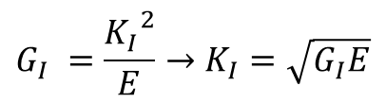
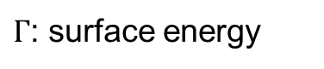
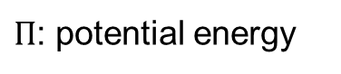
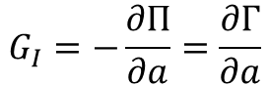
Background – Fracture Mechanics
$$σ_{22}$$
Linear Elastic Fracture Mechanics (LEFM) can also be derived through thermodynamics and energy methods. The energy release rate (for a brittle material) is:
It requires energy to propagate a crack and create a larger crack surface!
In LEFM, the energy release rate is exactly related to the stress intensity factor:
$$G_{I}=−\frac{∂Π}{∂a}=\frac{∂Γ}{∂a}$$
$Π$: potential energy
$Γ$: surface energy
$$σ_{22}$$
Zehnder [1]
$$G_{I} =\frac{{K_{I}}^{2}}{E}→K_{I}=\sqrt{G_{I}E}$$

Slide 7


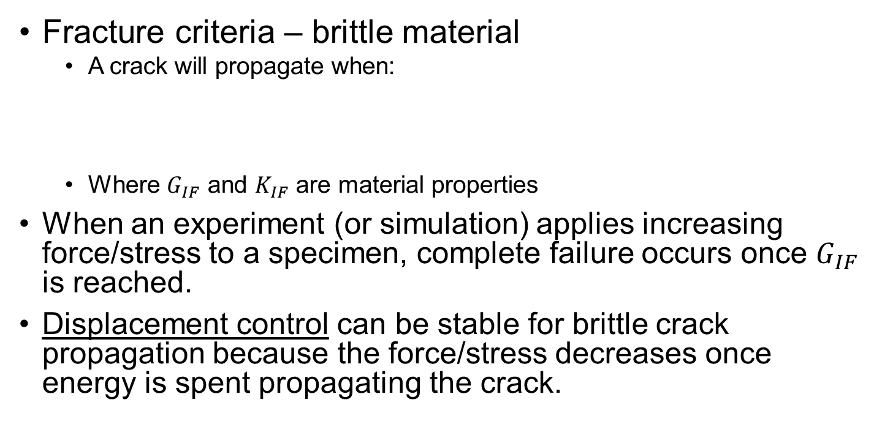
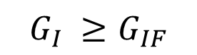
Background – Fracture Mechanics
$$σ_{22}$$
Fracture criteria – brittle material
A crack will propagate when:
Where $G_{IF}$ and $K_{IF}$ are material properties
When an experiment (or simulation) applies increasing force/stress to a specimen, complete failure occurs once $G_{IF}$ is reached.
Displacement control can be stable for brittle crack propagation because the force/stress decreases once energy is spent propagating the crack.
$$G_{I} ≥G_{IF}$$
$$or$$
$$K_{I} ≥K_{IF}$$
$$σ_{22}$$
Zehnder [1]

Slide 8
Background – Data Driven Fracture Mechanics
Many studies have been conducted to investigate data-driven constitutive model calibration and discovery:
[2] E. Haghighat, M. Raissi, A. Moure, H. Gomez, and R. James. “A Deep Learning Framework for Solution and Discovery in Solid Mechanics.” 2020, arXiv:2003.02751. URL http://arxiv.org/abs/2003.02751
[3] M. Raissi, P. Perdikaris, and G.E. Karniadakis. “Physics-informed neural networks: A deep learning framework for solving forward and inverse problems using nonlinear partial differential equations.” 2019, Journal of Computational Physics
[4] Z. Wang, X. Huan, and K. Garikipati. “Variational system identification of the partial differential equations governing the physics of pattern-formation: Inference under varying fidelity and noise.” 2019.
[5] Moritz Flaschel, Siddhang Kumar, and Larua De Lorenzis. “Unsupervised discovery of interpretable constitutive laws.” 2021, Computational Methods in Applied Mechanics and Engineering.
[6] Nikolaos N. Vlassis, Ran Ma, and WaiChing Sun. “Geometric deep learning for computational mechanics Part I: anisotropic hyperelasticity.” 2020, Computer Methods in Applied Mechanics and Engineering.
[7] Nikolaos N. Vlassis and WaiChing Sun. “Component-based Machine Learning Paradigm for Discovering Rate-dependent and pressure-sensitive Level-set Plasticity Models.” 2021, ASME Journal of Applied Mechanics.
Only several studies have applied data-driven methods to fracture mechanics with limited applicability to general situations/experiments:
[8] P. Carrara, L. De Lorenzis, L. Stainier, and M. Ortiz. “Data-driven fracture mechanics.” 2020, Computational Methods in Applied Mechanics and Engineering.
[9] P. Carrara, M. Ortiz, and L. De Lorenzis. “Data-driven rate-dependent fracture mechanics.” 2021, Journal of Mechanics and Physics of Solids.
[10] Yinan Wang, Diane Oyen, Weihong Guo, Anishi Mehta, Cory Braker Scott, Nishant Panda, M. Giselle Fernandez-Godino, Gowri Srinivasan, and Xiaowei Yue. “StressNet – Deep learning to predict stress with fracture propagation in brittle materials.” 2021, Nature partner journal of Materials Degradation.

Slide 9
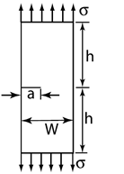
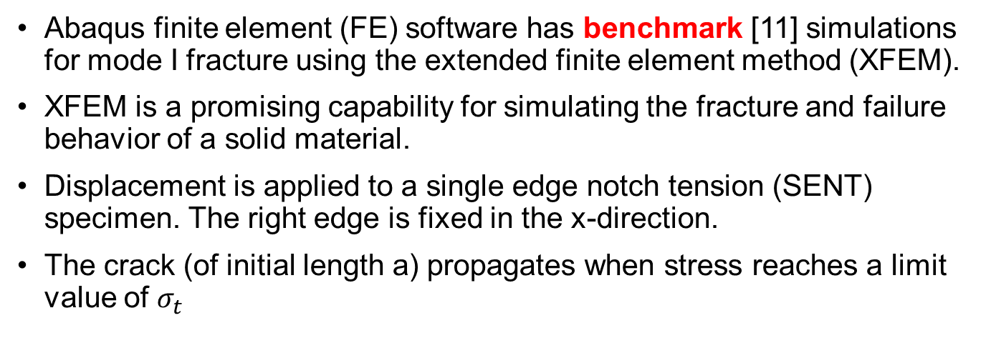
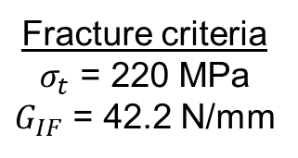
Input Data – Abaqus Simulations
u
Abaqus finite element (FE) software has benchmark [11] simulations for mode I fracture using the extended finite element method (XFEM).
XFEM is a promising capability for simulating the fracture and failure behavior of a solid material.
Displacement is applied to a single edge notch tension (SENT) specimen. The right edge is fixed in the x-direction.
The crack (of initial length a) propagates when stress reaches a limit value of $σ_{t}$
a = 300 mm
h = 1500 mm
W = 3000 mm
u = 1 mm
Elastic Modulus
Elastic parameters
E = 210 GPa
ν = 0.3
Fracture criteria
$σ_{t}$ = 220 MPa
$G_{IF}$ = 42.2 N/mm
Max tensile stress
u
Zehnder [1]
Poisson’s Ratio
Mode I fracture energy release rate

Slide 10
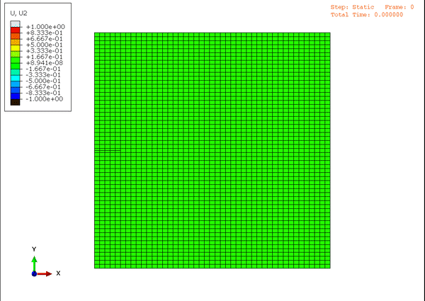
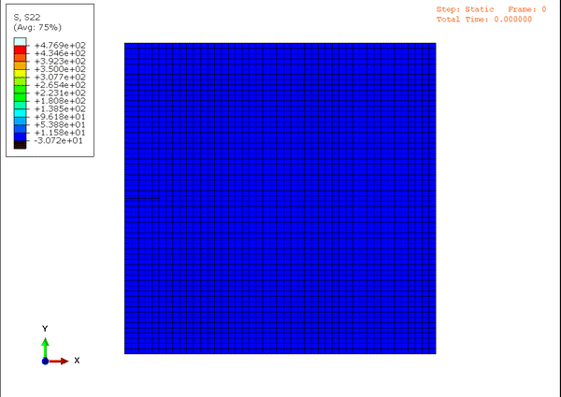
Input Data – Abaqus Fracture
u
a = 300 mm
h = 1500 mm
W = 3000 mm
u = 1 mm
Mode I tension, Abaqus benchmark [11]
Default mesh, 2655 elements and 2760 nodes
u
y-displacements
Normal stress in y-direction
Zehnder [1]
Deformed geometry is exaggerated by 100x

Slide 11
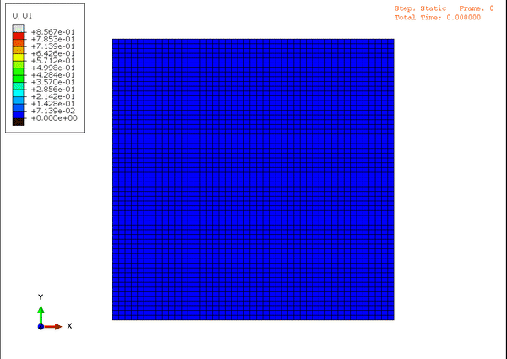

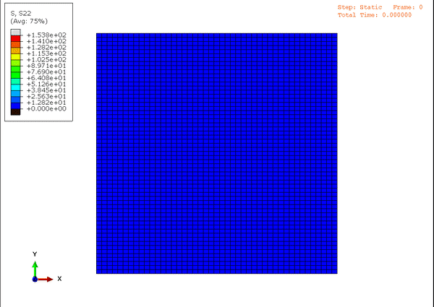
Input Data – Abaqus Elastic
Elastic parameters
E = 210 GPa
ν = 0.3
Before developing a PINN for the fracture problem, we decided we would try a simpler problem.
Crack removed, all other dimensions and simulations parameters were kept the same.
Pure uniaxial stress state!
x-displacements
y-displacements
Normal stress in y-direction

Slide 12
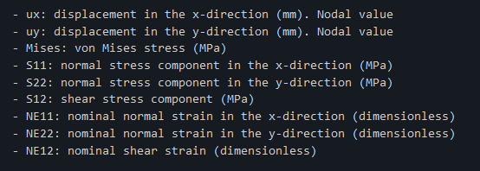
Input Data – Extraction
Used scripts written in Abaqus/Python API to extract nodal results from Abaqus output database (ODB)
Xarray “DataArray” for each timestep → stack into “DataSet”
Fields :
Used as input to our PINNs
This data could be analogous to “digital image correlation” (DIC) from a real experiment
Used to compare solutions

Slide 13
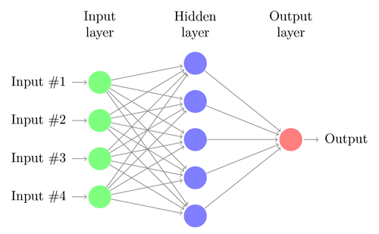

Background - Intro to Neural Networks
Neural networks (NNs), also called “artificial” neural networks include components such as:
Inputs
Layers with neurons, each have weights, biases, and activation functions
Outputs
Cost functions
Artificial “neurons” connect input to output in “layers.” Layers of neurons are considered hidden layers. There may be few to many hidden layers.
The lines that connect neurons across layers are the actual network! A matrix is constructed between each layer and associated “weights” are determined by the training method.
Basic 1-layer NN
Relationship between NNs, DL, ML, and AI

Slide 14
Background - Intro to Neural Networks
Machine learning, in general, revolves around optimization. Neural networks specifically optimize over a compositional cost function:
A compositional function is a function of functions! In this case, subsequent layers of the NN are functions of the previous layers.
This is solved using minimization and back propagation algorithms.
Mathematical complexity depends on
number of layers
number of neurons
network architecture
hyper-parameter selection
Each matrix A_{k} denotes the weights connecting the NN from the k^{th} to the (k+1)^{th}
Massively underdetermined system! Final term provides regularization.

Slide 15
Background - Intro to Neural Networks
Training NNs requires training data, a minimization algorithm (such as Stochastic Gradient Descent), and a backpropagation algorithm.
“Backpropagation computes the gradient of the loss function with respect to the weights of the network for a single [layer at a time]” - wikipedia/Backpropagation
This is how the weights are determined! Layer-by-layer in reverse
Requirements for training a NN is specific to the NN architecture, the problem at hand, testing data, and a tunable set of “hyperparameters.”
Basic 1-layer NN

Slide 16
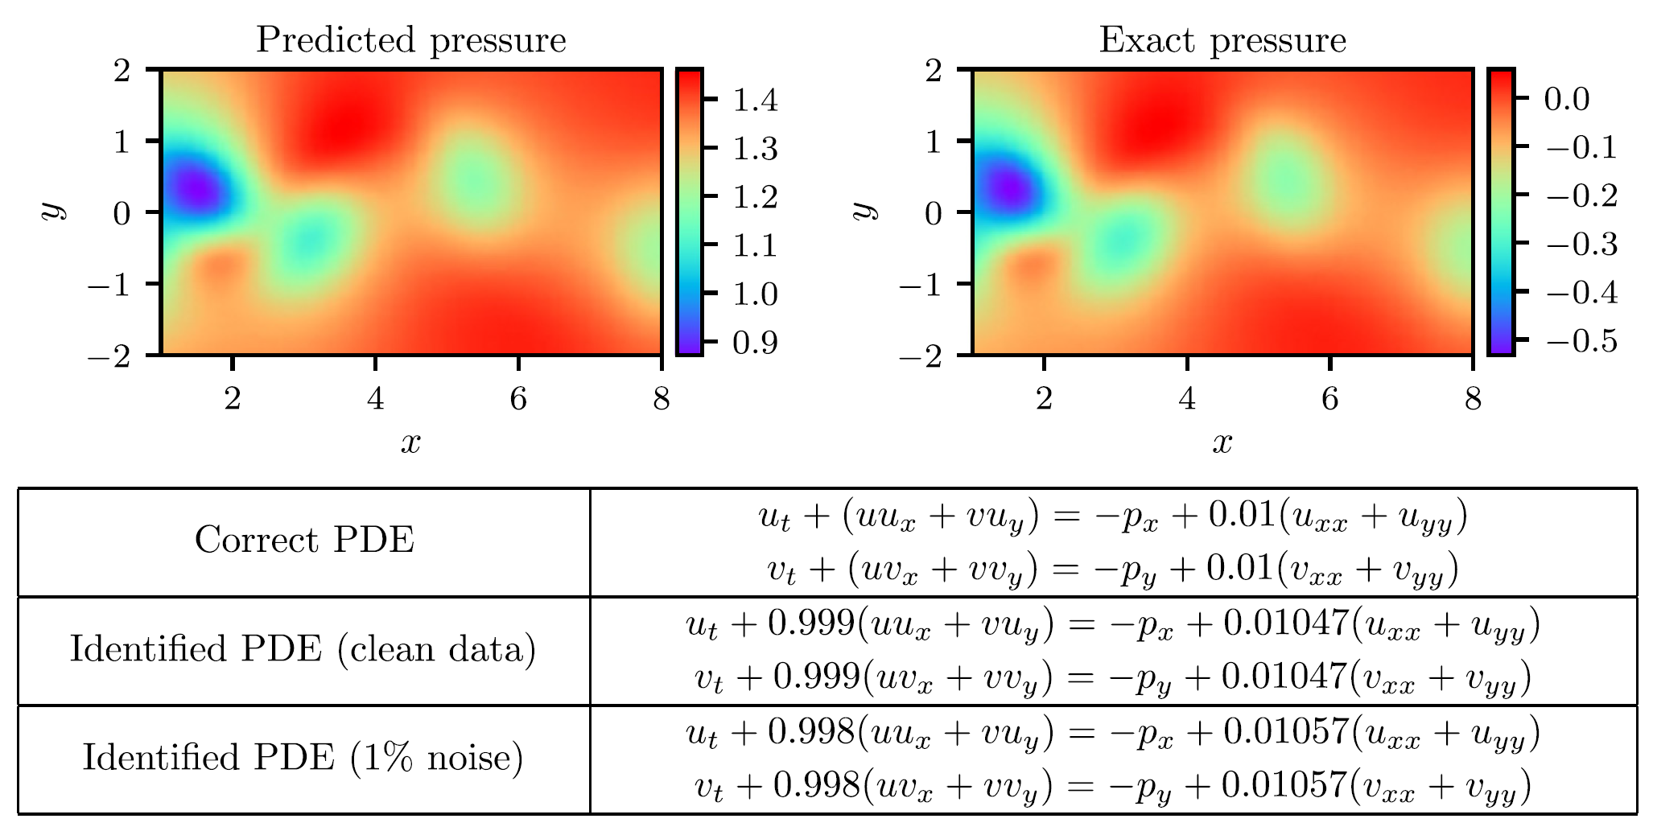
Physics-Informed Neural Networks (PINNs)
Physics-informed neural networks (PINNs) are neural networks which are:
Trained to solve supervised learning tasks
Respect any given laws of physics, described by general nonlinear partial differential equations
To set up a PINN, we differentiate neural networks with respect to their input coordinates and model parameters.
This helps constrain the PINN to respect symmetries, invariances, or conservation principles originating from physical laws that govern the input data.
For our PINNs, we enforce a momentum balance in the x- and y-directions using our stress measures!
Raissi et al. 2019 [3]
Navier-Stokes equation using a PINN

Slide 17
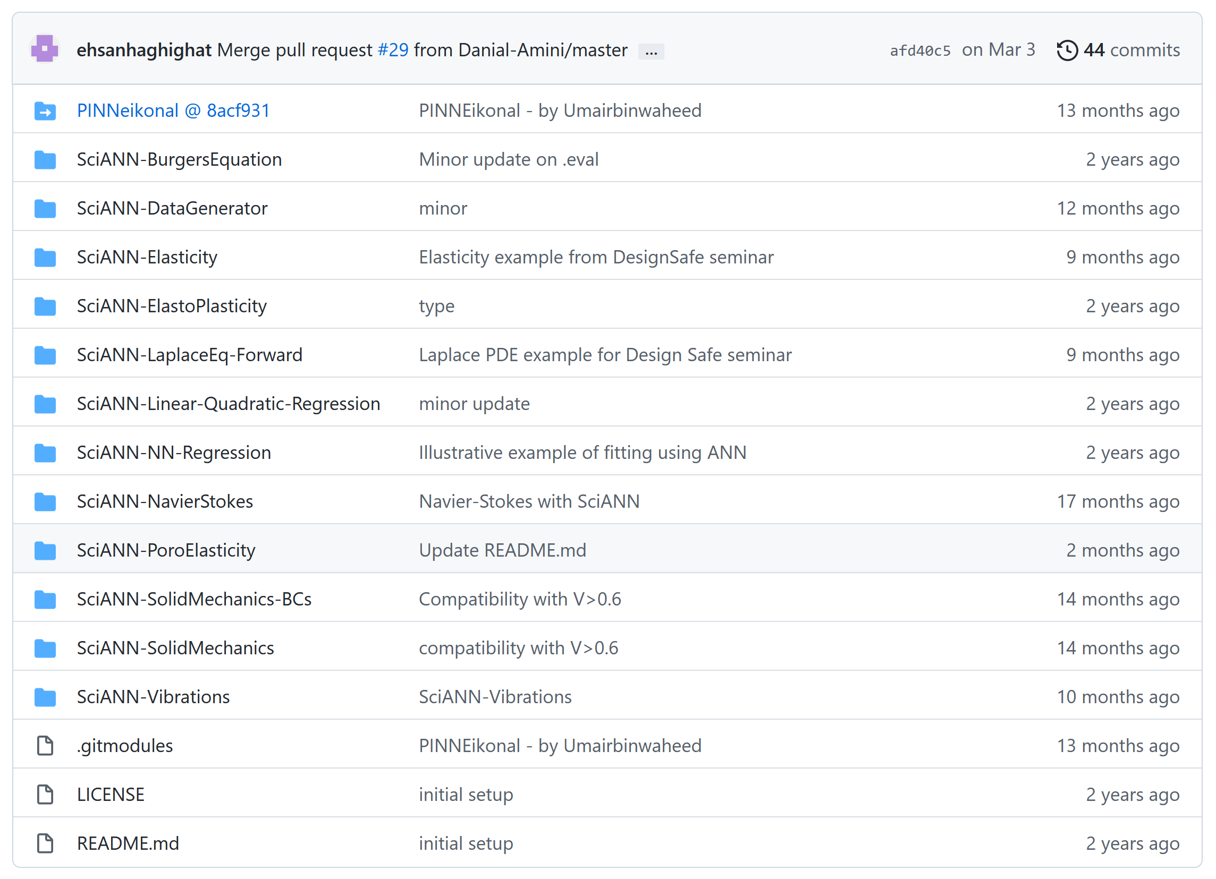
Using Python SciANN for PINNs
SciANN is a high-level artificial neural networks API, written in Python using Keras and TensorFlow backends.
Enabling fast experimentation with different networks architectures since a NN can be set up with only a few lines of code.
Developed with an emphasis on scientific computations, physics informed deep learning, and inversion.
Includes examples based on recent literature.
Based our PINN on this example [2]
https://github.com/sciann/sciann-applications

Slide 18
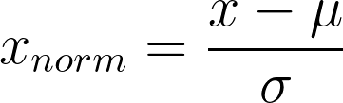
Data Transformation Methods for PINNs
Transforming data before inputting into a machine learning method such as neural networks can significantly improve performance.
Some common data transformations include:
Normalization, or translating data into a different range, such as [0, 1] or simply transforming data to be on a unit sphere, useful when not making assumptions about the distribution of the input data
Standardization, or setting the mean of the data to 0 and the standard deviation to 1, works well if data follows a Gaussian distribution
Normalization, in particular helps make the gradient descent in the NN move more smoothly toward minima and steps move more uniformly
For our PINNs, we used z-score normalization:

Slide 19
Hyperparameter Selection for PINN
Hyperparameters are knobs in a NN to improve the performance of a neural network. Some hyperparameters that we explored are:
Batch size: Number of samples from a dataset used to evaluate one gradient update. A batch-size of 1 would be associated with a full stochastic gradient descent optimization.
Epoch: Rounds of training on a dataset
Learning rate (lr): Determines the step size at each iteration (of the gradient descent) while moving toward a minimum of a loss function, sets the trade-off between convergence and overshooting
Reduce lr after: Reduce learning rate once learning stagnates
The architecture of the NN itself can also be tweaked including:
# of layers
# of neurons in each layer

Slide 20
Goals for our PINNs
Implement PINN on a purely elastic system
Discover elastic parameters and replicate system parameters
Implement PINN for a similar system with a fracture
Discover failure criteria and replicate system parameters
Explore Noise
Notes:
https://github.com/thomas-allard/datafrac

Slide 21
Goals for our PINNs
Implement PINN on a purely elastic system
Discover elastic parameters and replicate system parameters
Implement PINN for a similar system with a fracture
Discover failure criteria and replicate system parameters
Explore Noise
Notes:
https://github.com/thomas-allard/datafrac

Slide 22
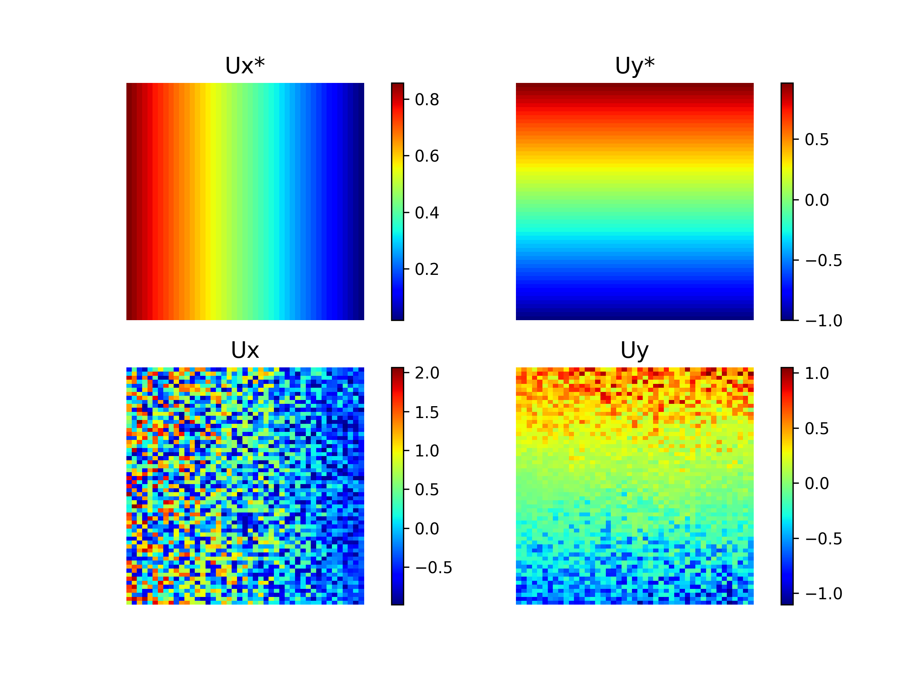
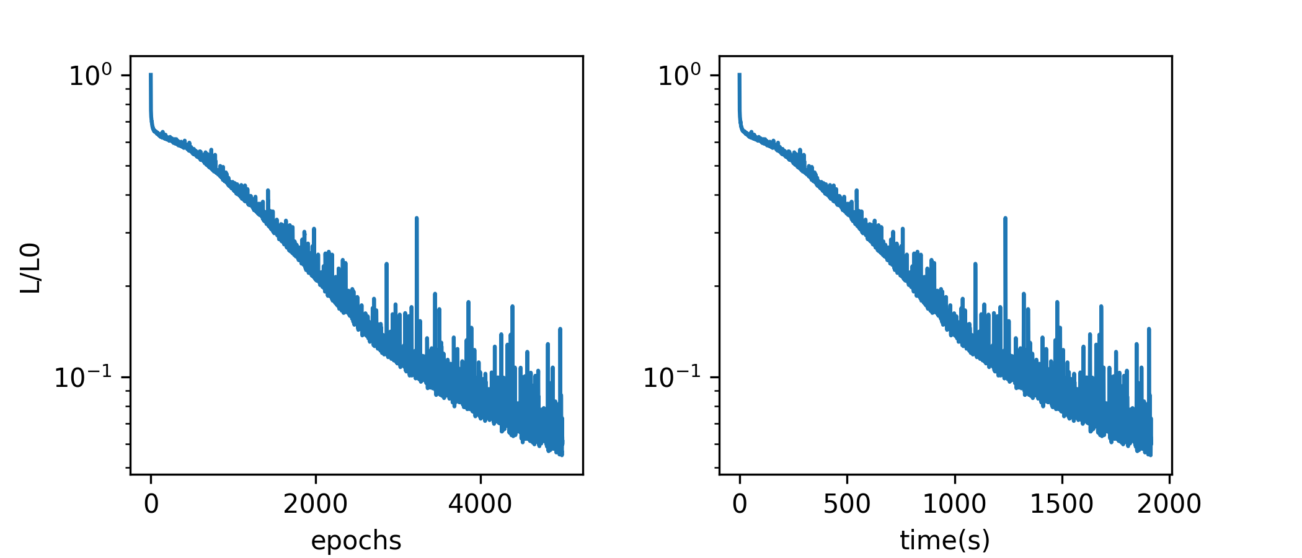
Elastic PINN
Troubles! ☹

Slide 23
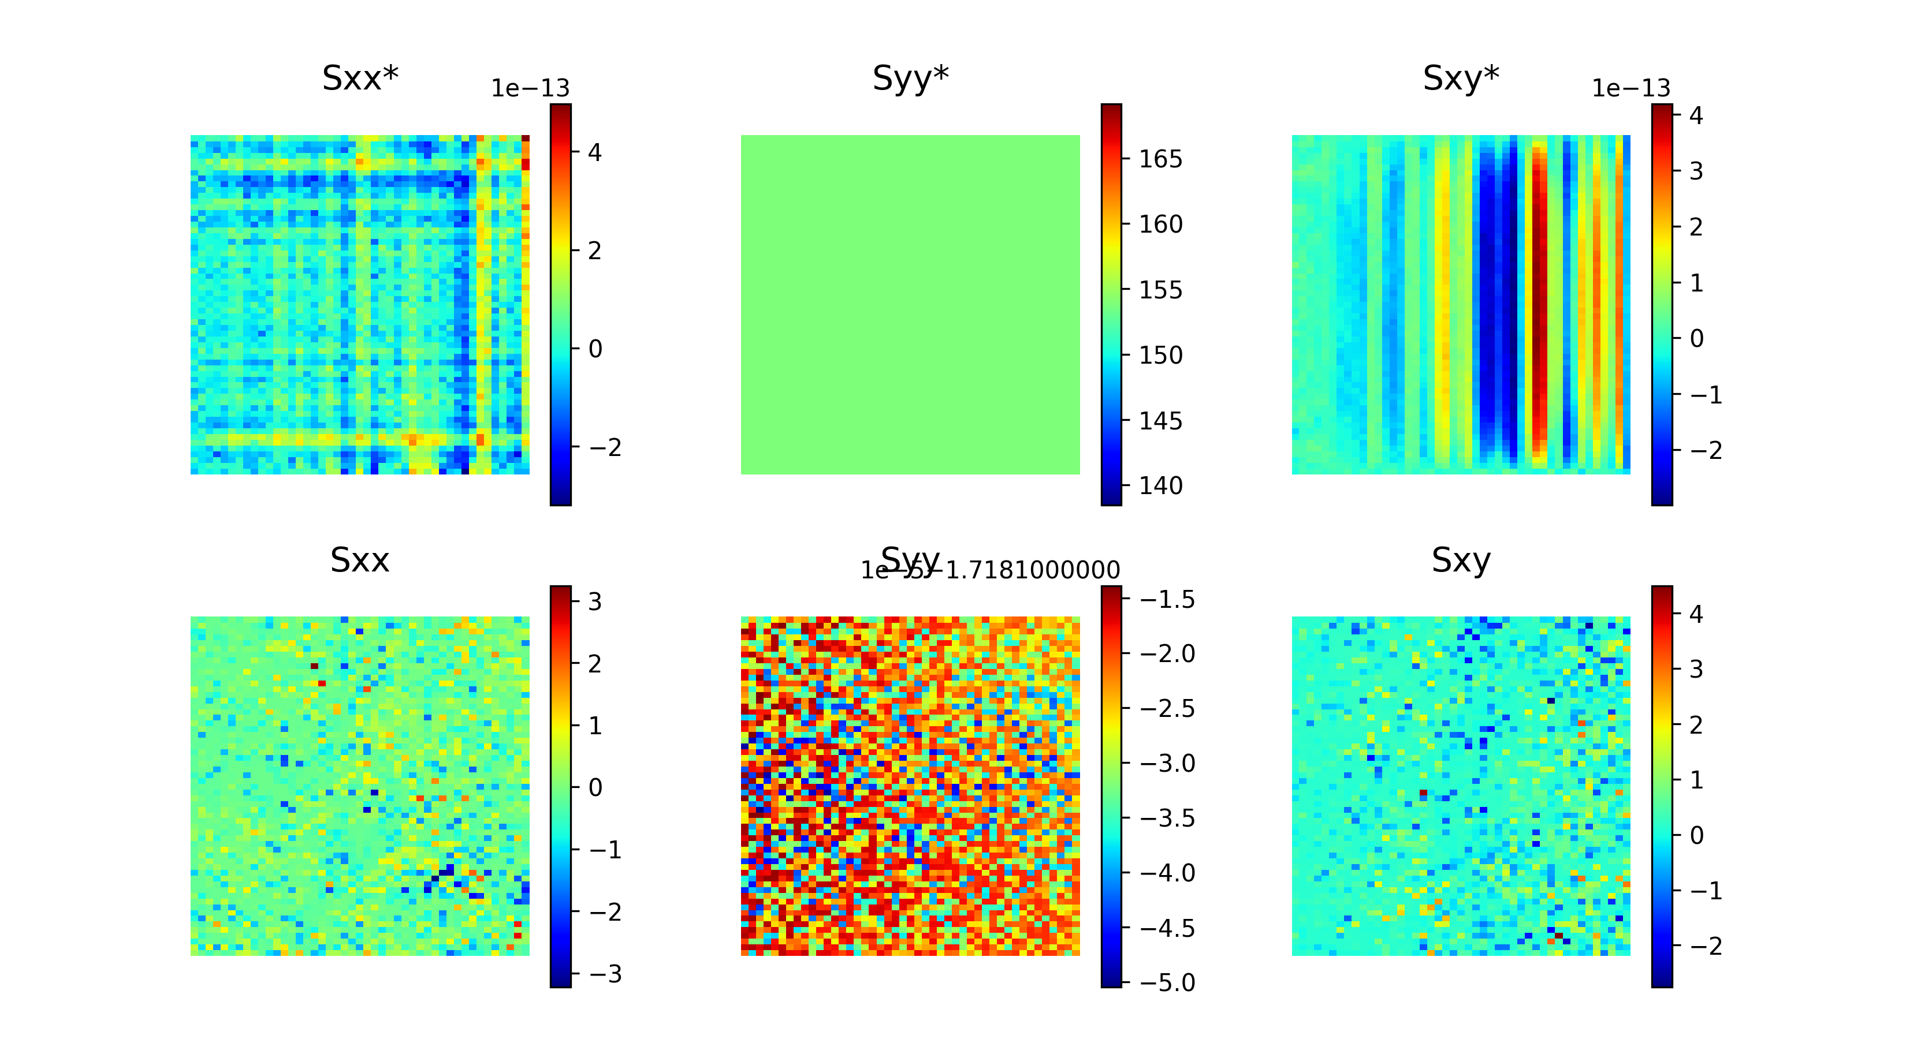
Elastic PINN
Troubles! ☹
Many things were attempted…
Show code

Slide 24
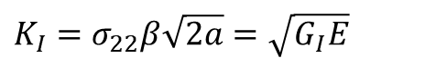
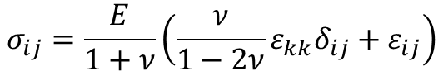
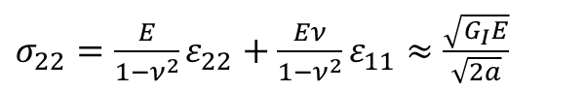
Fracture PINN
Since we were unable to get the elastic PINN working fully, we did not implement a PINN for the fracture case
☹
Plan if things went well:
Input the stress intensity factor into constitutive equations and relate to the fracture energy criteria to train PINN
$K_{I}=$ $σ_{22}β\sqrt{2a}=\sqrt{G_{I}E}$
$$σ_{ij}=\frac{E}{1+ν}\left(\frac{ν}{1−2ν}ε_{kk}δ_{ij}+ε_{ij}\right)$$
$σ_{22}=\frac{E}{1−ν^{2}}ε_{22}+\frac{Eν}{1−ν^{2}}ε_{11}≈$ $\frac{\sqrt{G_{I}E}}{\sqrt{2a}}$

Slide 25
Conclusions
Why are PINNs so hard ☹
Feel free to help us:
https://github.com/thomas-allard/datafrac
Next things to try/do:
Fix elastic
Get fracture to work
Add noise

Slide 26
References
[1] Alan T. Zehnder. “Fracture Mechanics: Lecture Notes in Applied and Computational Mechanics.” 2012, Springer.
[2] E. Haghighat, M. Raissi, A. Moure, H. Gomez, and R. James. “A Deep Learning Framework for Solution and Discovery in Solid Mechanics.” 2020, arXiv:2003.02751. URL http://arxiv.org/abs/2003.02751
[3] M. Raissi, P. Perdikaris, and G.E. Karniadakis. “Physics-informed neural networks: A deep learning framework for solving forward and inverse problems using nonlinear partial differential equations.” 2019, Journal of Computational Physics
[4] Z. Wang, X. Huan, and K. Garikipati. “Variational system identification of the partial differential equations governing the physics of pattern-formation: Inference under varying fidelity and noise.” 2019.
[5] Moritz Flaschel, Siddhang Kumar, and Larua De Lorenzis. “Unsupervised discovery of interpretable constitutive laws.” 2021, Computational Methods in Applied Mechanics and Engineering.
[6] Nikolaos N. Vlassis, Ran Ma, and WaiChing Sun. “Geometric deep learning for computational mechanics Part I: anisotropic hyperelasticity.” 2020, Computer Methods in Applied Mechanics and Engineering.
[7] Nikolaos N. Vlassis and WaiChing Sun. “Component-based Machine Learning Paradigm for Discovering Rate-dependent and pressure-sensitive Level-set Plasticity Models.” 2021, ASME Journal of Applied Mechanics.
[8] P. Carrara, L. De Lorenzis, L. Stainier, and M. Ortiz. “Data-driven fracture mechanics.” 2020, Computational Methods in Applied Mechanics and Engineering.
[9] P. Carrara, M. Ortiz, and L. De Lorenzis. “Data-driven rate-dependent fracture mechanics.” 2021, Journal of Mechanics and Physics of Solids.
[10] Yinan Wang, Diane Oyen, Weihong Guo, Anishi Mehta, Cory Braker Scott, Nishant Panda, M. Giselle Fernandez-Godino, Gowri Srinivasan, and Xiaowei Yue. “StressNet – Deep learning to predict stress with fracture propagation in brittle materials.” 2021, Nature partner journal of Materials Degradation.
[11] Abaqus Benchmarks Guide, section 1.19.1 “Crack propagation of a single-edge notch simulated using XFEM.” 2016

